Slide 2
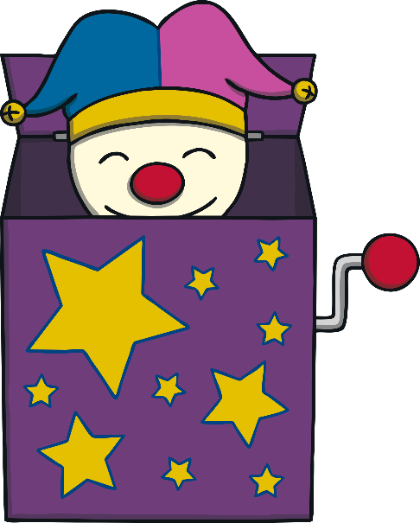
Contents
Rainbow Counting
How Many Buzzy Bees?
Swim and Count
Countdown to Lift Off!
Snowflake Estimation
Magic Spell Estimation
Autumn Leaves Estimation
Fish Pond Estimation
Hide, Count and Seek
Jack-in-the-Box Counting
Counting Flowers in the Meadow
How Many Fairies?
Ladybird Estimation

Slide 3
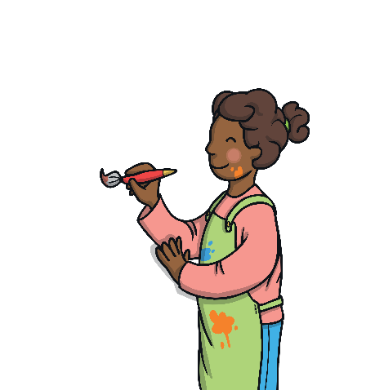
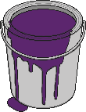
Rainbow Counting
back
The rainbow paint has washed away! Click the paint buckets in the correct order to fix the rainbow. Start with painting number 10 at the bottom of the rainbow.
How many arches does the rainbow have? How do you know? How can you check?
reset
click again
10
15
11
12
16
20
13
17
19
14
18
Click on the painter to reveal questions that encourage the development of children’s mathematical reasoning skills.

Slide 4
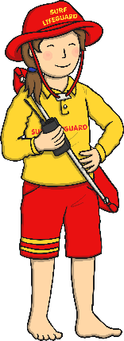
back
Swim and Count
How many swimmers are there to begin with?
How will you keep track of how many you have counted?
Can you count backwards from 20 as each swimmer splashes into the pool? Click on each swimmer to make them jump into the pool.
reset
click again
Click on the lifeguard to reveal questions that encourage the development of children’s mathematical reasoning skills.

Slide 5
Snowflake Estimation
back
Can you estimate how many snowflakes have fallen from the sky?
Can you explain how you decided on your estimate? What helped you to estimate?
Click on the answer button to check how many there were.
Were you close?
start snowflakes
reset
click again
Click on the snowman to reveal questions that encourage the development of children’s mathematical reasoning skills.
answer

Slide 6
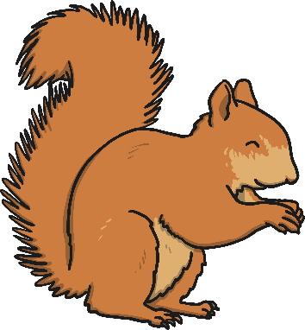
Autumn Leaves Estimation
back
Can you estimate how many leaves the wind blew off the tree?
Can you see any groups of leaves to help you with your estimate? How can we check?
Can you see any groups of leaves to help you with your estimate? How can we check?
reset
reset
click for wind
Click on the squirrel to reveal questions that encourage the development of children’s mathematical reasoning skills.

Slide 7
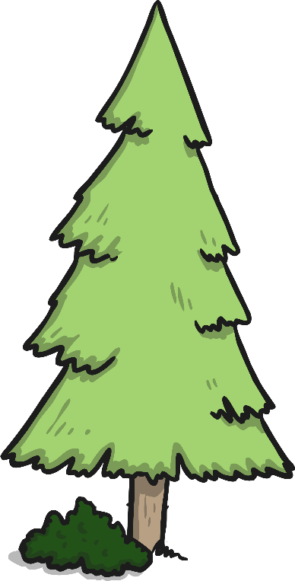
Hide, Count and Seek
back
Can you help me to count backwards as my friend hides? I am going to count down from 14 to 0 to give them time to hide!
hide
Can I just say the numbers in any order?
When you are counting backwards from 14, how do you know what number to say next?
Click on the boy to reveal questions that encourage the development of children’s mathematical reasoning skills.

Slide 8
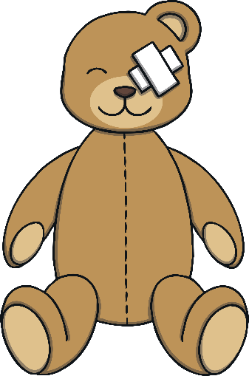
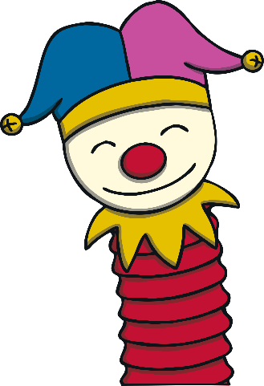
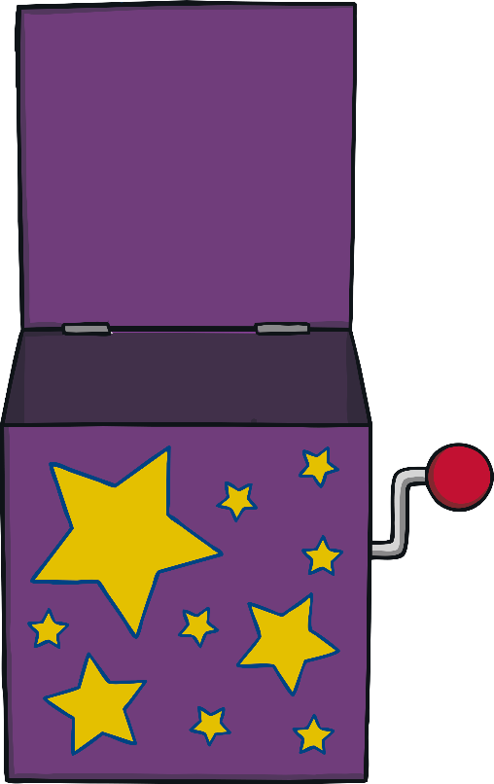
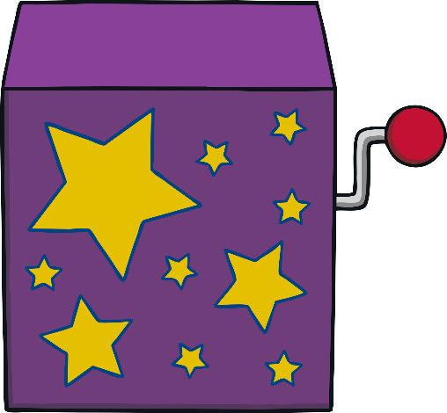
Jack-in-a-Box Counting
back
How long will Jack be hiding in the box? Can you count?
How did you know when to stop counting?
reset
open box
Click on the teddy bear to reveal questions that encourage the development of children’s mathematical reasoning skills.

Slide 9
Counting Flowers in the Meadow
back
Can you count each flower as it grows?
How many flowers are growing in the meadow?
How can you be sure you counted all of them?
start flowers
reset
click again
Click on the butterfly to reveal questions that encourage the development of children’s mathematical reasoning skills.

Slide 10
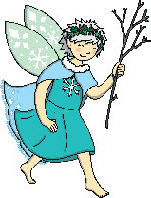
How Many Fairies Estimation
back
The fairies are very shy. They will only appear for a short time. How many do you estimate there are?
show fairies
hide fairies
Were there more than 10? How do you know?
Were there less than 20?
How many fairies did you see?

Slide 11
Ladybird Estimation
back
Only ladybirds with more than 10 spots can land on this leaf.
reveal
hide
Do you think this ladybird has more than 10 spots? How do you know?
How many spots do you think the ladybird has? Why did you pick that number? Can the ladybird land on this leaf?

Slide 12
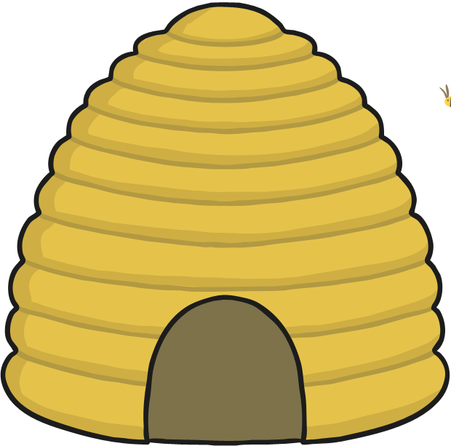
How Many Buzzy Bees?
back
How many bees are there? How can we count them? I think there are 15 bees in the hive. Am I correct?
reorder bees
click for answer
18

Slide 13
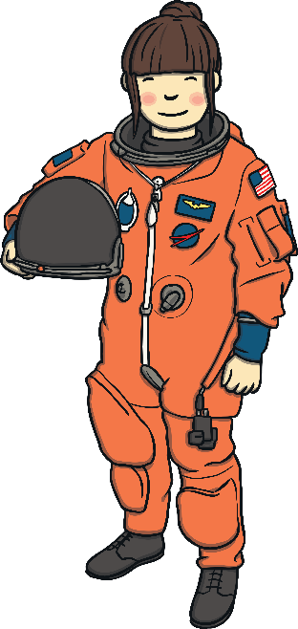
Countdown to Lift Off!
back
What number do we start counting down from? What number would we say next? Can we start counting at any number?
Can you help the rocket launch? Count down from 20. When you reach 0, it is time for lift off!
reset
Lift Off!
20 19 18 17 16 15 14 13 12 11 10 9 8 7 6 5 4 3 2 1 0
Click on the astronaut to reveal questions that encourage the development of children’s mathematical reasoning skills.

Slide 14
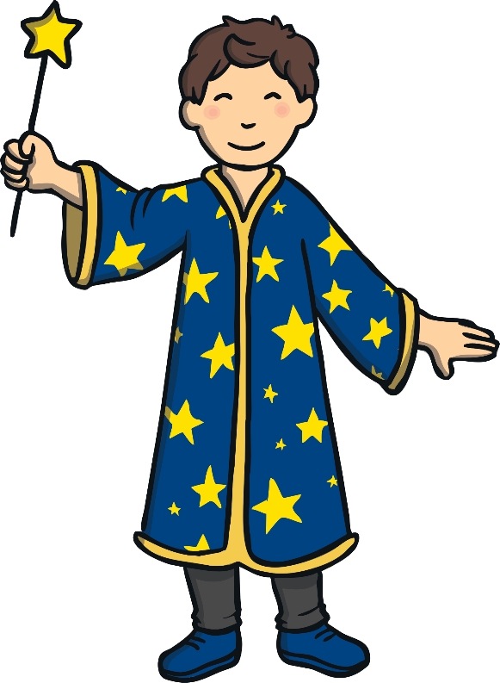
Magic Spell Estimation
back
How many cakes do you think the wizard made? What is your estimate?
Click on the wizard to help him cast a magic cake spell!

Slide 15
Fish Pond Estimation
back
finish
How many fish did you see? What is your estimate? How did you count the fish? Can you explain your estimate to a friend?
hide fish
show fish

